Slide 1
Version Control System

Slide 2
Agenda
What / Why Version Control
Centralized VCS vs Distributed VCS
What / Why Git
Git Features and Commands
Git File Workflow
Overview of Remote Repositories
Working with GitHub
Integrating Git & GitHub

Slide 3
Why Version Control
Version control software is an essential part of the every-day of the modern software team's professional practices.
Version control software keeps track of every modification to the code in a special kind of database.
Version control protects source code from both catastrophe and the casual degradation of human error and unintended consequences.
Helps teams to solve problems like, tracking every individual change by each contributor and helping prevent concurrent work from conflict.
Conflicts if any should be solved using help of tool or manually.

Slide 4
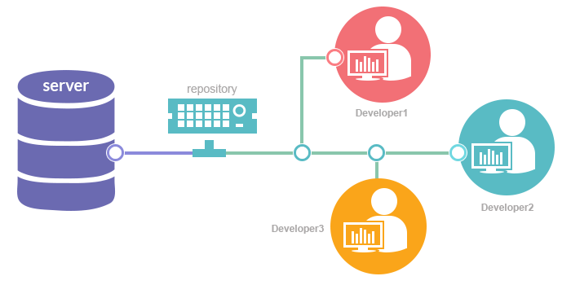
What is Version Control System
Allows multiple users to manage multiple revisions of the same unit of information.
Practice of tracking and managing changes to software code.
Version control systems are software tools that help software teams manage changes to source code over time
Developers can compare earlier versions of the code with an older version to fix the mistakes.

Slide 5
Benefits of Version Control
No need to keep multiple backups.
Allows multiple people to work on same file / project.
A complete long-term change history of every file.
Branching and merging – maintain code as per projects / release / functionality etc.
Traceability - ability to trace each change made to the software and connect it to project management and bug tracking software.
Easily switch / work on earlier file versions.

Slide 6
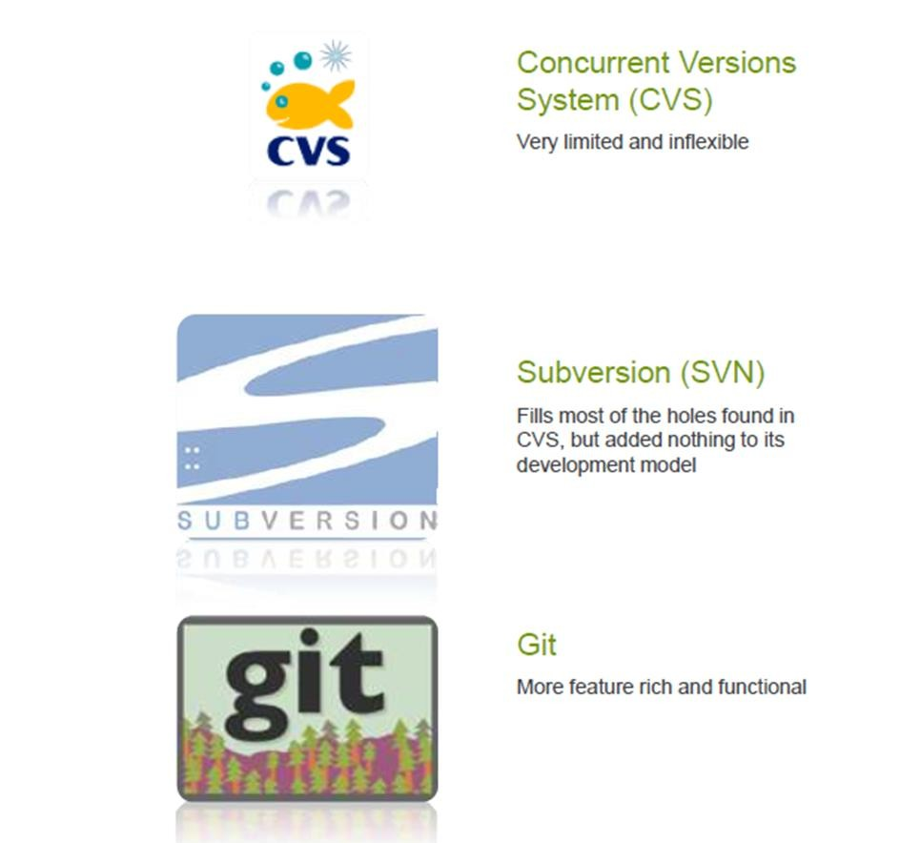
Various Version Control Systems

Slide 7
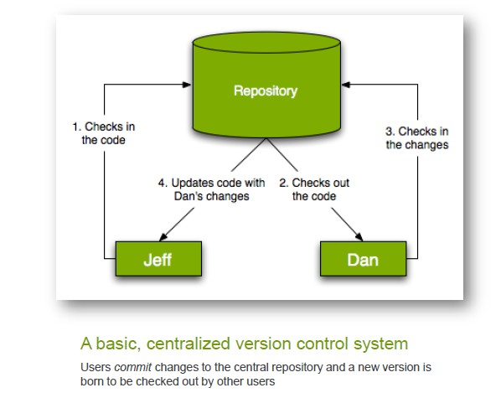
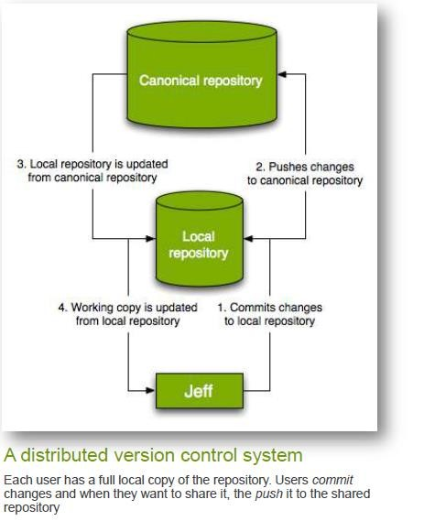
Central VCS & Distributed VCS

Slide 8
Overview Of Central VCS
Workflow:
Pull down any changes other people have made from the central server.
Make your changes, and make sure they work properly.
Commit your changes to the central server, so other programmers can see them.
Example: SVN

Slide 9
Benefits and Disadvantages of Central VCS
Benefits:
Project history and database is maintained on centralized server, beneficial incase of large project size and history.
Disadvantages:
Internet / network connection is must.
Frequent (daily) database sync is necessary.
Pull and push to centralized server can be time taking.

Slide 10
Overview of Distributed VCS
Workflow:
Clone entire repository on local machine.
Maintain all code changes on local machine.
Incase of sharing the code with others, merge the code on central GIT repo.

Slide 11
Benefits And Disadvantages
Benefits:
Extremely fast, as database resides on local drive.
Committing to a changeset can be done locally. Group of changesets then can be pushed to remote repository.
No need of internet connection.
Disadvantages:
Initial cloning and maintaining huge database can eat up space on local machine.
Database backup should be done locally.

Slide 12
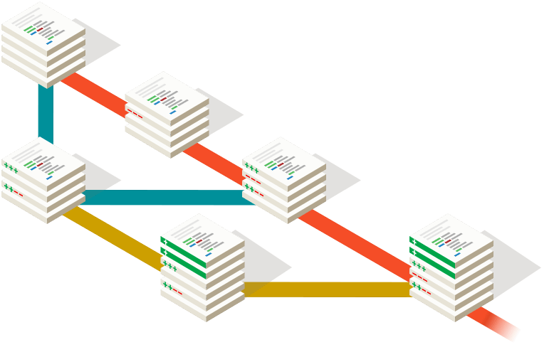
Overview Of Git
Git is a Distributed Version Control tool that supports distributed non-linear workflows by providing data assurance for developing quality software.
Git provides with all the Distributed VCS facilities to the user that was mentioned earlier. Git repositories are very easy to find and access.

Slide 13
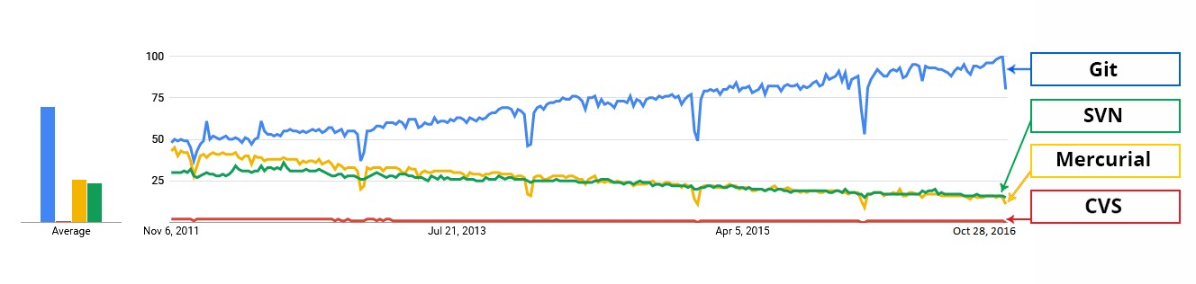
Git in the Market

Slide 14
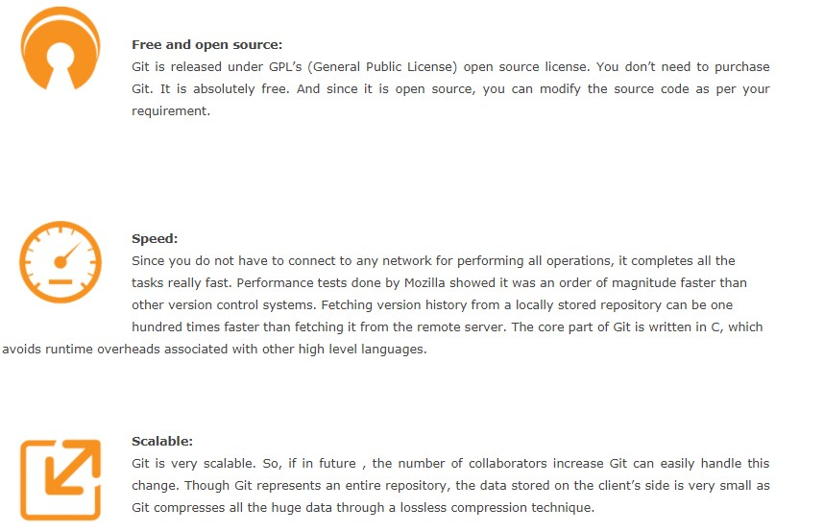
Git Features

Slide 15
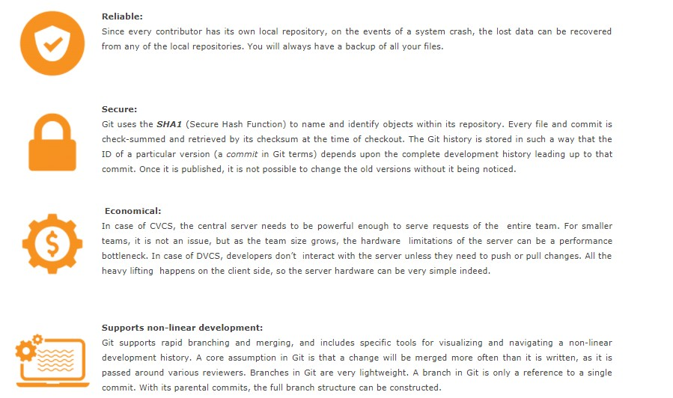
Git Features ..Contd

Slide 16
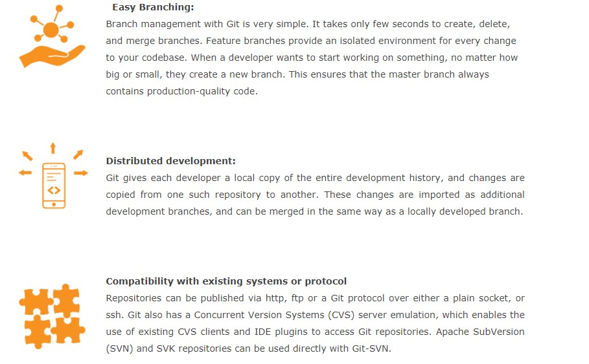
Git Features ..Contd

Slide 17
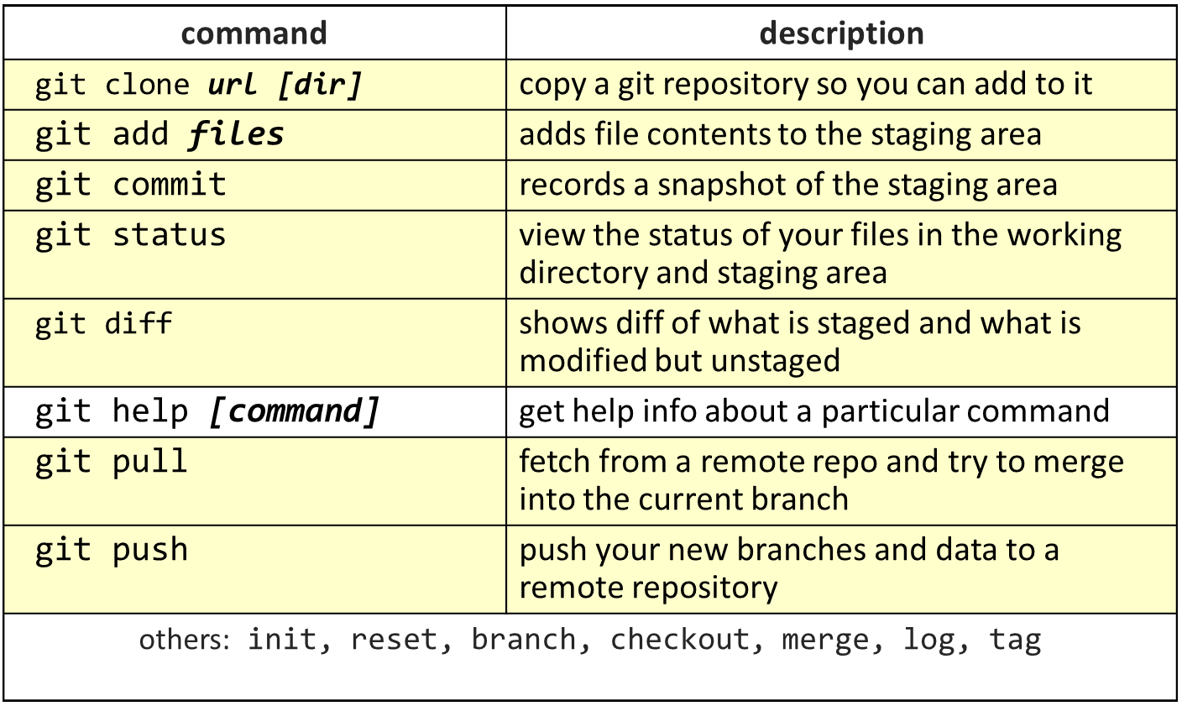
Important Git Commands

Slide 18

File Lifecycle
Modify files in your working directory.
Stage files, adding snapshots of them to your staging area.
Do a commit, which takes the files as they are in the staging area and stores that snapshot permanently to your Git directory.
Unmodified/modified Files
Staged Files
Committed
Files

Slide 19





Remote Repositories
A remote repository is place where the users upload and share their commits with other collaborators.
Git uses some repositories management services like Github, Gitlab, Bitbucket etc.

Slide 20

Overview Of GitHub
GitHub is a web-based hosting service for version control using git.
It offers all of thea distributed version control and source code management (SCM) functionality of Git as well as adding its own features.
It provides access control and several collaboration features such as bug tracking, feature requests, task management, and wikis for every project.

Slide 21

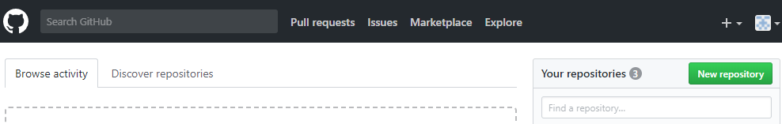



Creating Repository
Creating a Remote Repository
Sign-up at github.com
Click on New repository to create a new repository

Slide 22
CrCreating Repository
a Remote Repository
Under Repository name, give a name to your repository
Give some Description about your repository under Description section.
Creatisitory
For a free repository choose public
Finally click on Create Repository

Slide 23
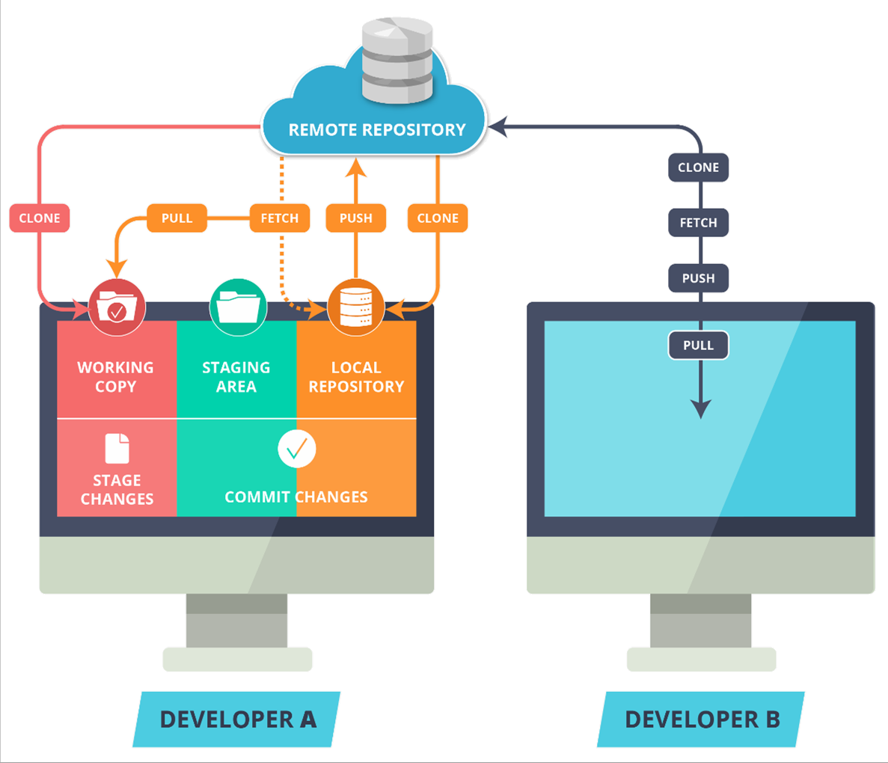
Git Workflow
Git Workflow
Use Git workflow to manage your project effectively
Working with set of guidelines increases Git’s consistency and productivity

Slide 24
Git Workflow
The Remote Repository is the server where all the collaborators upload changes made to the files

Slide 25

Local and Remote Repository
Git Workflow
“Local Repository” is user’s copy of the Version Database
The user accesses all the files through local repository and then push the change made to the “Remote Repository”

Slide 26

Git Workspace
Git Workflow
“Workspace” is user’s active
directory
The user modifies existing files and creates new files in this space. Git tracks these changes compared to your Local Repository

Slide 27

Git Workflow
Stage is a place where all the modified files marked to be committed are placed.

Slide 28

Git Workflow
Clone command creates a copy of an existing Remote Repository inside the Local Repository.

Slide 29

Git Workflow
Commit command commits all the files in the staging area to the local repository.

Slide 30

Git Workflow
Push command pushes all the changes made in the Local Repository to the Remote Repository

Slide 31

Git Workflow
Fetch command collects the changes made in the Remote repository and copies them to the Local Repository. This
command doesn’t affect our Workspace.

Slide 32

Git Workflow
Pull like Fetch, gets all the changes from the remote repository and copies them to the Local Repository
Pull merges those changes to the current working directory

Slide 33

Git Branches
Git Branches
A project in its development could take multiple different paths to achieve its goal.
Branching helps us take these different directions, test them out and in the end achieve the required goal.

Slide 34




Integrating Git with GitHub
To add Remote repository to local use git add remote followed by remote link
Syntax: git add remote origin <remote link>
Remote link

Slide 35




Adding Remote Repository To Local Repository
Integrating Git with GitHub
To push Local repository to remote use push command
Syntax: git push origin master
Origin is an alias for your remote
Master is the name of the branch you are pushing from local to remote
To push other branches to remote use the following command
Syntax: git push –u origin <branch-name>

Slide 36
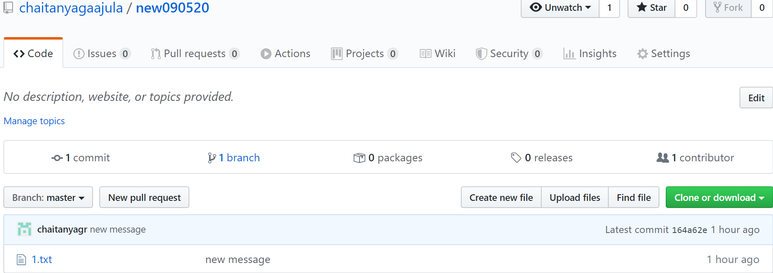
Working with GitHub Repository
Push Local Repository To Remote
The changes can be seen in Remote repository

Slide 37
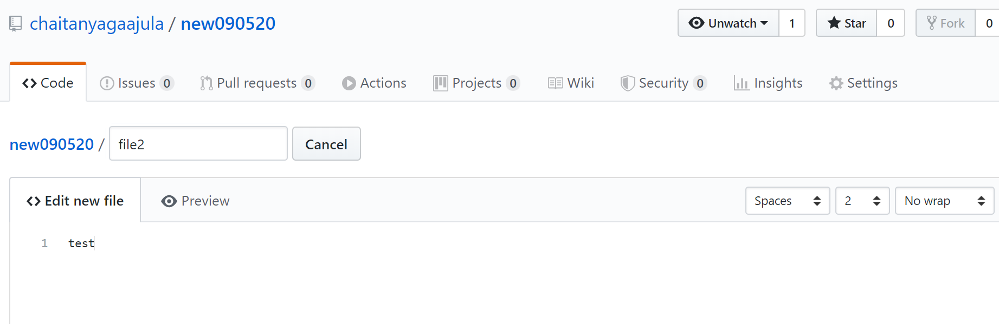
Working on Remote
Files can be created and edited on remote
Working with GitHub Repository

Slide 38
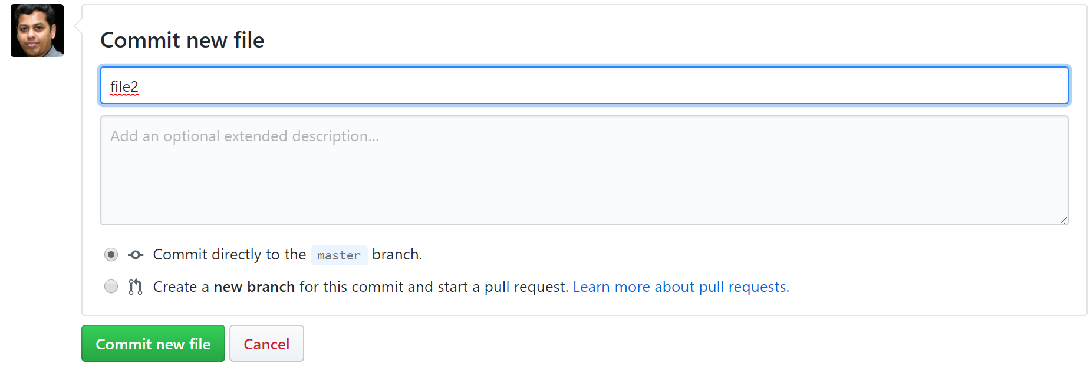
Working on Remote
These files can then be committed on the remote
Working with GitHub Repository

Slide 39

tWorking with GitHub Repository
To list all the remotes attached to your Local repository
Syntax: git remote -v
Git Pull
Pull copies all the changes from remote to local repository
It then merges the changes with the present working directory
Syntax: git pull origin

Slide 40
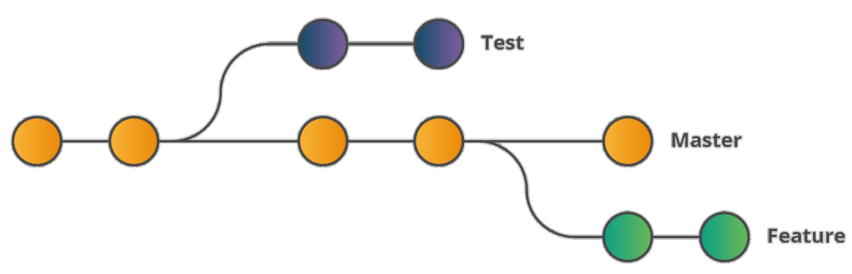
Git Branches
Branching is an integral part of any Version Control(VC) System
Unlike other VC’s Git does not create a copy of existing files for new branch
It points to snapshot of the changes you have made in the system

Slide 41




Syntax: git branch <branchname>
Git Branch Commands
Creating a Branch
To create a new branch from your current branch
You can then switch to this newly created branch
Syntax: git checkout <branchname>

Slide 42




Git Branch Commands
Creating a Branch
Creating and switching to a new branch can be done with using -b flag
Syntax: git checkout -b <branchname>
Branch command lists all the branches and also points to the current working branch
Syntax: git branch

Slide 43

Git Merge
Merging in Git
Merging integrates the changes made in different branches into one single branch
Syntax: git merge <branchname>
The branch mentioned is merged into the current branch

Slide 44
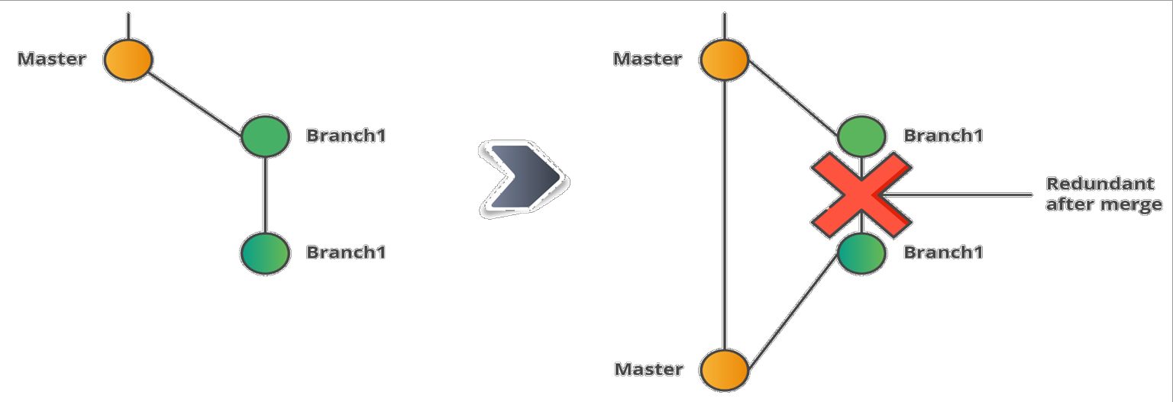
Git Merge
Merging in Git
All the changes made in Branch1 after merging are available in the Merged branch(Master)
Branch1 becomes redundant after merging, hence it can be deleted

Slide 45




Syntax: git branch -d <branchname>
Git Merge Commands
Deleting a Branch
Merged branches can be deleted using -d flag
Unmerged branches can be deleted using -D flag
Syntax: git branch -D <branchname>

Slide 46

Git Revert
Considered an 'undo' type command.
Instead of removing the commit from the project history, it figures out how to invert the changes introduced by the commit and appends a new commit with the resulting inverse content.
Prevents Git from losing history, which is important for the integrity of your revision history and for reliable collaboration.

Slide 47
Thank You

